Slide 1

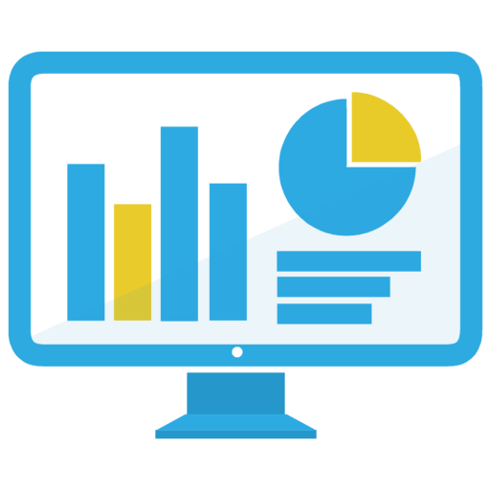

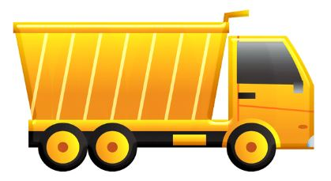
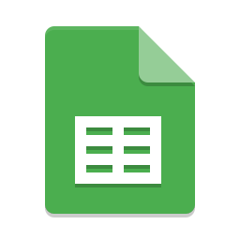
Driver
Truck
Dashboard
Maintenance Engineer
Mobile App
CO₂ Sensor
Controller
CAN Bus App
Machine Learning
Input driver credentials
Efficiency & Recommendation
Collect CO₂ data
Data collection
Collect fuel consumption data
Data processing & analytics
Maintenance
Needed?

